Slide 1
Business Statistics:
A First Course
(3rd Edition)
Chapter 9
Hypothesis Tests for Categorical Data from Two or More Samples

Slide 2
Chapter Topics
Z Test for Differences in Two Proportions (Independent Samples)
χ² Test for Differences in Two Proportions (Independent Samples)
χ² Test for Differences in More than Two Proportions (Independent Samples)
χ² Test of Independence

Slide 3
Z Test for Differences in Two Proportions
What is it used for?
  To determine whether there is a difference between 2 population proportions and whether one is larger than the other
Assumptions:
  Independent samples
  Population follows Binomial distribution
  Sample size large enough: np ≥ 5 and n(1-p) ≥ 5 for each population

Slide 4
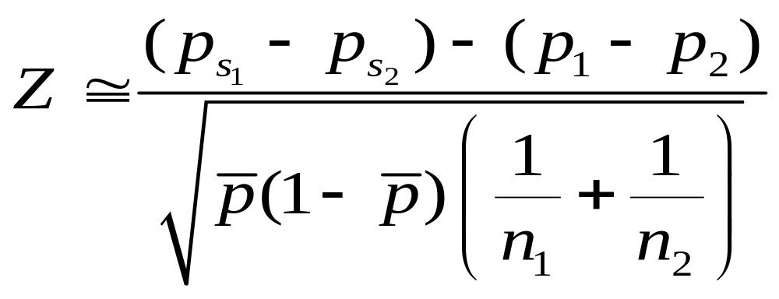
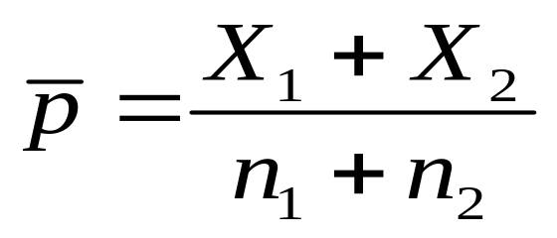
Z Test Statistic
Where
Pooled Estimate of the Population Proportion
X₁ = Number of Successes in Sample 1
X₂ = Number of Successes in Sample 2

Slide 5
The Hypotheses for the
Z Test
Research Questions
No Difference
Prop 1
Prop 2
≥
Prop 1
≤
Hypothesis
Prop 2
Any Difference
Prop 1 < Prop 2
Prop 1 > Prop 2
H
p
-
p
= 0
p
-
p
≥
0
p
-
p
≤
0
0
1
2
1
2
1
2
p
-
p
≠
p
-
p
< 0
p
-
p
> 0
H
0
1
1
2
1
2
1
2

Slide 6
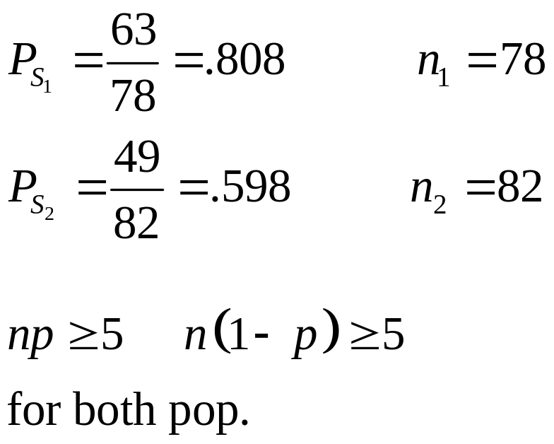

Z Test for Differences in Two Proportions: Example
As personnel director, you want to test the perception of fairness of two methods of performance evaluation. 63 of 78 employees rated Method 1 as fair. 49 of 82 rated Method 2 as fair. At the 0.01 significance level, is there a difference in perceptions?
✓

Slide 7
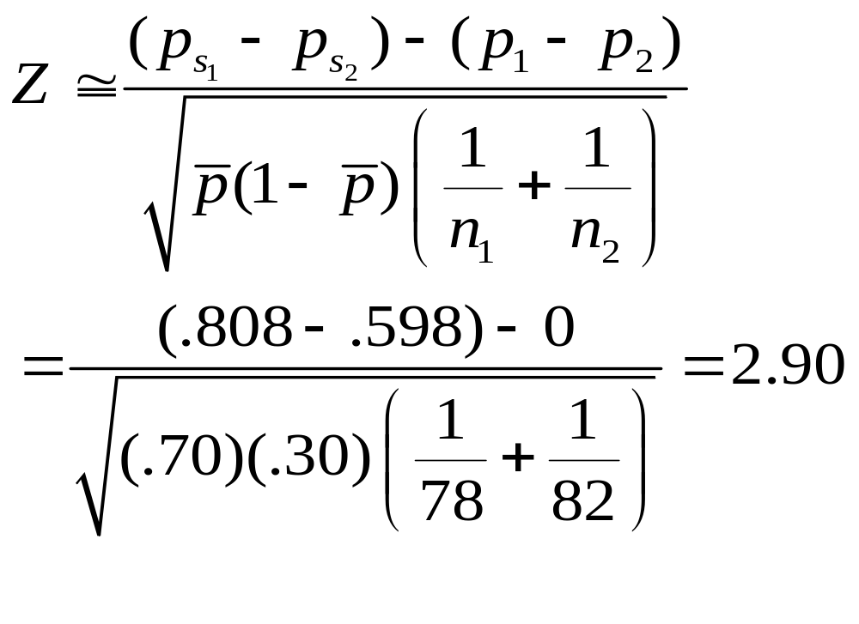
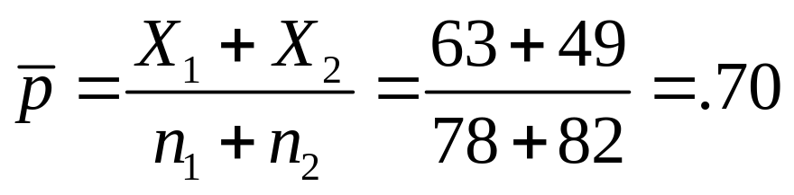
Calculating the Test Statistic

Slide 8
Z Test for Differences in Two Proportions: Solution
H₀: p₁ - p₂ = 0
H₁: p₁ - p₂ ≠ 0
α = 0.01
n₁ = 78 n₂ = 82
Critical Value(s):
Test Statistic:
Decision:
Conclusion:
Z
≅
2
.
90
Reject at α = 0.01
Reject H
Reject H
0
0
.005
.005
There is evidence of a difference in proportions.
-2.58
0
2.58
Z

Slide 9

Z Test for Difference in Two Proportions in PHStat
PHStat | Two-Sample Tests | Z Test for Differences in Two Proportions …
Example Solution in Excel Spreadsheet

Slide 10
χ² Test for Two Proportions: Basic Idea
Compares Observed to Expected Frequencies if Null Hypothesis is True
The Closer Observed Frequencies are to Expected Frequencies, the More Likely the H₀ is True
  Measured by squared difference relative to expected frequency
  Sum of relative squared differences is the test statistic

Slide 11
χ² Test for Two Proportions: Contingency Table
Contingency Table (Observed Frequencies) for Comparing Fairness of Performance Evaluation Methods
2 Populations
Evaluation Method
Perception
1
2
Total
Fair
63
49
112
Unfair
15
33
48
Total
78
82
160
Levels of Variable

Slide 12
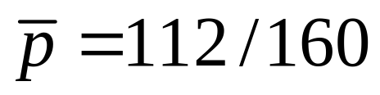
χ² Test for Two Proportions: Expected Frequencies
112 of 160 Total Are “Fair” ( )
78 Used Evaluation Method 1
Expect (78 × 112/160) = 54.6 to be “Fair”
Evaluation Method
Perception
1
2
Total
Fair
63
49
112
Unfair
15
33
48
Total
78
82
160

Slide 13
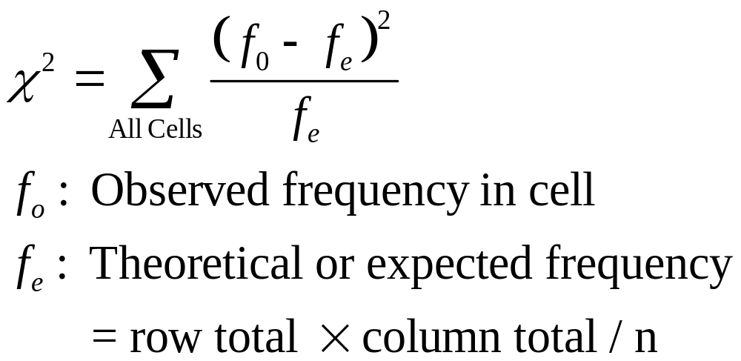
The χ² Test Statistic

Slide 14
Computation of the χ² Test Statistic
f₀ f_{e} (f₀ - f_{e}) (f₀ - f_{e})² (f₀ - f_{e})² / f_{e}
63 54.6 8.4 70.56 1.293
49 57.4 -8.4 70.56 1.229
15 23.4 -8.4 70.56 3.015
33 24.6 8.4 70.56 2.868
Sum = 8.405
Observed Frequencies
Expected Frequencies

Slide 15
χ² Test for Two Proportions:
Finding the Critical value
df = (r - 1)(c - 1) = 1
r = 2 (# rows in Contingency Table)
c = 2 (# columns)
α = .01
Reject
α = .01
0
6.635
χ²
χ² Table (Portion)
Upper Tail Area
DF
.995
…
.95
…
.05
.025
.01
1
...
…
0.004
…
3.841
5.024
6.635
2
0.010
…
0.103
…
5.991
7.378
9.210

Slide 16
χ² Test for Two Proportions:
Solution
Caution! Each expected frequency should be ≥ 5.
H₀: p₁ - p₂ = 0
H₁: p₁ - p₂ ≠ 0
Test Statistic = 8.405
Decision:
Conclusion:
Reject
Reject at α = 0.01
α = .01
There is evidence of a difference in proportions.
χ²
0
6.635
Note: Conclusion obtained using χ² test is the same as using Z Test.

Slide 17
χ² Test for Two Proportions in PHStat
PHStat | Two-Sample Tests | Chi-Square Test for Differences in Two Proportions …
Example Solution in Excel Spreadsheet

Slide 18
χ² Test for More than Two Proportions
Extends the χ² Test to the General Case of c Independent Populations
Tests for Equality (=) of Proportions Only
One Variable with Several Groups or Levels
Uses Contingency Table
Assumptions:
  Independent random samples
  “Large” sample size
  All expected frequencies ≥ 1

Slide 19
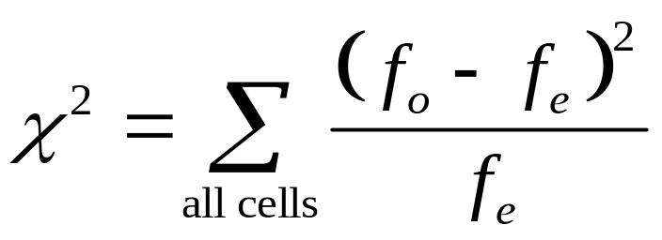
χ² Test for c Proportions:
Hypotheses and Statistic
Hypotheses
  H₀: p₁ = p₂ = ... = p_{c}
  H₁: Not all p_{j} are equal
Test statistic
Degrees of freedom: (r - 1)(c - 1)
Observed frequency
Expected frequency
# Rows # Columns

Slide 20

χ² Test for c Proportions:
Example
The University is thinking of switching to a trimester academic calendar. A random sample of 100 undergraduates, 50 graduate students and 50 faculty members were surveyed.
Opinion Under Grad Faculty
Favor 63 27 30
Oppose 37 23 20
Totals 100 50 50
Test at the .01 level of significance to determine if there is evidence of a difference in attitude between the groups.

Slide 21
χ² Test for c Proportions:
Example
(continued)
1. Set Hypotheses:
  H₀: p₁ = p₂ = p₃
  H₁: Not All p_{j} Are Equal
2. Contingency Table:
✓
All expected frequencies are large.
Opinion Under Grad Faculty Totals
Favor 63 27 30 120
Oppose 37 23 20 80
Totals 100 50 50 200

Slide 22
χ² Test for c Proportions:
Example
(continued)
3. Compute Expected Frequencies
Opinion Under Grad Faculty Totals
Favor 60 30 30 120
Oppose 40 20 20 80
Totals 100 50 50 200
(100)(120)/200=60
(50)(80)/200=20

Slide 23
χ² Test for c Proportions:
Example
(continued)
4. Compute Test Statistic:
f₀ f_{e} (f₀ - f_{e}) (f₀ - f_{e})² (f₀ - f_{e})² / f_{e}
63 60 3 9 .15
27 30 -3 9 .30
30 30 0 0 .0
37 40 -3 9 .225
23 20 3 9 .45
20 20 0 0 .0
Test Statistic χ² = 1.125

Slide 24
χ² Test for c Proportions:
Example Solution
  H₀: p₁ = p₂ = p₃
  H₁: Not All p_{j} Are Equal
  Decision:
  Conclusion:
df = (c – 1)(r - 1) = 3 - 1 = 2
Reject
Do Not Reject H₀
α = .01
χ
0
9.210
2
Since χ² =1.125, there is insufficient evidence of a difference in attitude among the groups.

Slide 25

χ² Test for c Proportions in PHStat
PHStat | c-Sample Tests | Chi-Square Test …
Example Solution in Excel Spreadsheet

Slide 26
χ² Test of Independence
Shows if a Relationship Exists between 2 Factors of Interest
  One sample drawn
  Each factor has 2 or more levels of responses
  Does not show nature of relationship
  Does not show causality
Similar to Testing p₁ = p₂ = … = p_{c}
Used Widely in Marketing
Uses Contingency Table

Slide 27
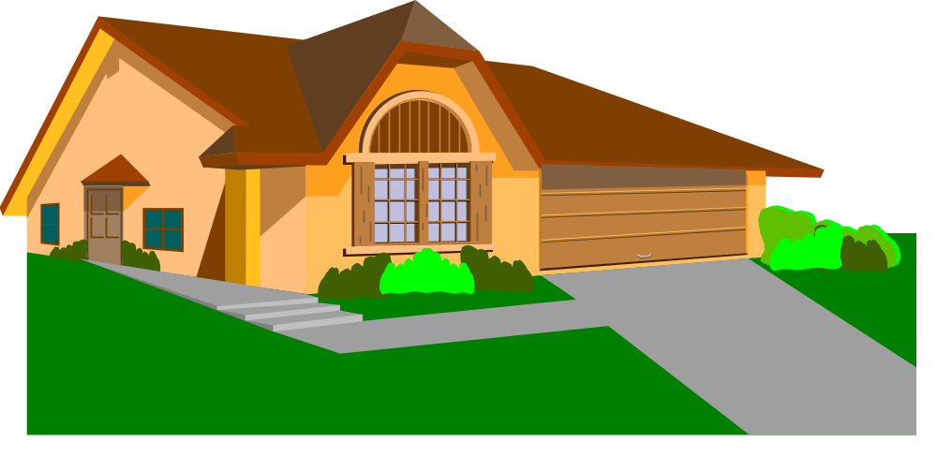
χ² Test of Independence:
Example
A survey was conducted to determine whether there is a relationship between architectural style (split level or ranch) and geographical location (urban or rural).
Given the survey data, test at the α = .01 level to determine whether there is a relationship between location and architectural style.

Slide 28
χ² Test of Independence:
Example
(continued)
1. Set Hypotheses:
H₀: The 2 categorical variables (Architectural Style and Location) are independent
H₁: The 2 categorical variables are related
2. Contingency Table:
House Location
House Style
Urban
Rural
Total
Levels of Variable 1
Split-Level
63
49
112
Ranch
15
33
48
Total
78
82
160
Levels of Variable 2

Slide 29
χ² Test of Independence:
Example
(continued)
3. Computing Expected Frequencies
  Statistical independence : P(A and B) = P(A)·P(B)
  Compute marginal (row & column) probabilities & multiply for joint probability
  Expected frequency is sample size times joint probability
78·112
160
House Location
82·112
160
Urban
Rural
House Style
Obs.
Exp.
Obs.
Exp.
Total
Split-Level
63
54.6
49
57.4
112
Ranch
15
23.4
33
24.6
48
Total
78
78
82
82
160

Slide 30
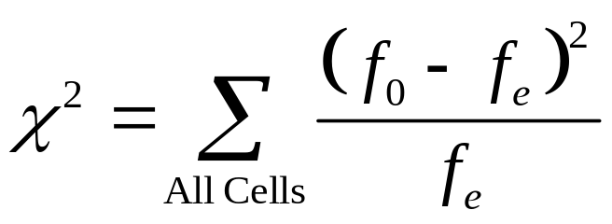
χ² Test of Independence:
Example
(continued)
4. Calculate Test Statistic:
f₀ f_{e} (f₀ - f_{e}) (f₀ - f_{e})² (f₀ - f_{e})² / f_{e}
63 54.6 8.4 70.56 1.292
49 57.4 -8.4 70.56 1.229
15 23.4 -8.4 70.56 3.015
33 24.6 8.4 70.56 2.868
8.404
✓
χ² Test Statistic = 8.404
All expected frequencies are large, i.e > 1.

Slide 31
χ² Test of Independence:
Example Solution
H₀: The 2 categorical variables (Architectural Style and Location) are independent
H₁: The 2 categorical variables are related
  Decision:
  Conclusion:
df = (r - 1)(c - 1) = 1
Reject
α = .01
Reject H₀ at α = .01
χ
0
6.635
2
Since χ² =8.404, there is evidence that the choice of architectural design and location are related.

Slide 32

χ² Test of Independence in PHStat
PHStat | c-Sample Tests | Chi-Square Test …
Example Solution in Excel Spreadsheet

Slide 33
Chapter Summary
Performed Z Test for Differences in Two Proportions (Independent Samples)
Discussed χ² Test for Differences in Two Proportions (Independent Samples)
Addressed χ² Test for Differences in More than Two Proportions (Independent Samples)
Described χ² Test of Independence

